Slide 1
WHEN SWEET KIDS ACT LIKE WILD MONKEYS
Mark Jones
Facebook- Mr. Mark’s Classroom
Pinterest- Mr. Mark’s Classroom
Instagram- @mr.marks_classrm

Slide 2
SIGNS THAT WILD MONKEYS ARE COMING

Slide 3
SIGNS THAT WILD MONKEYS ARE COMING
WHERE’S YOUR TEACHER?

Slide 4
SIGNS THAT WILD MONKEYS ARE COMING
WHERE’S YOUR TEACHER?
BOYS PLAY

Slide 5
SIGNS THAT WILD MONKEYS ARE COMING
WHERE’S YOUR TEACHER?
BOYS PLAY
GIRLS SAY

Slide 6
WHAT’S THE SOLUTION?
Provide teacher expectations through procedures.

Slide 7
Why do we need Procedures?
Spiritual Formations of Children

Slide 8
Why do we need Procedures?
Spiritual Formations of Children
Provides Safety

Slide 9
Why do we need Procedures?
Spiritual Formations of Children
Provides Safety
Children Can’t Read Your Mind

Slide 10
Why do we need Procedures?
Spiritual Formations of Children
Provides Safety
Children Can’t Read Your Mind
Learning is More Productive

Slide 11
Why do we need Procedures?
Spiritual Formations of Children
Provides Safety
Children Can’t Read Your Mind
Learning is More Productive
Rules Get Tested

Slide 12
Lead With Procedures

Slide 13
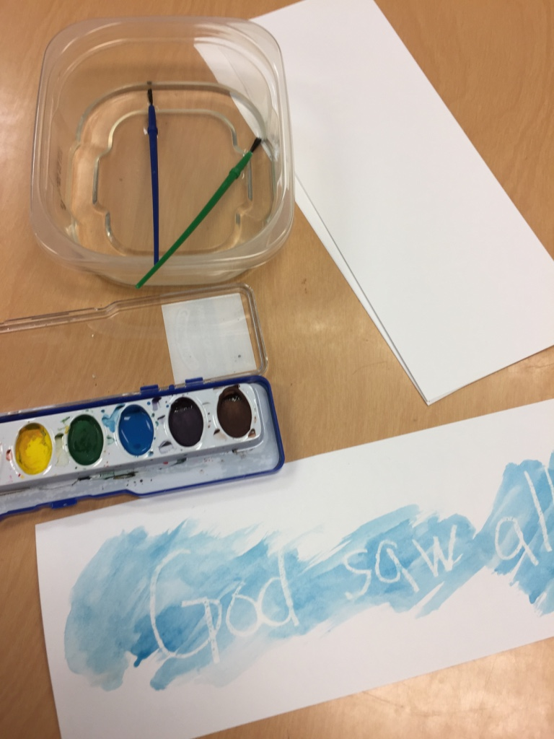
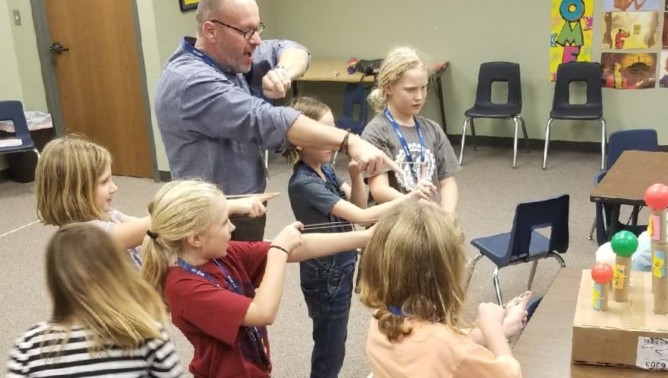
Ready for Arrival
Teacher is present
Classroom is clean
Arrival activities are ready
Greeting by name

Slide 14
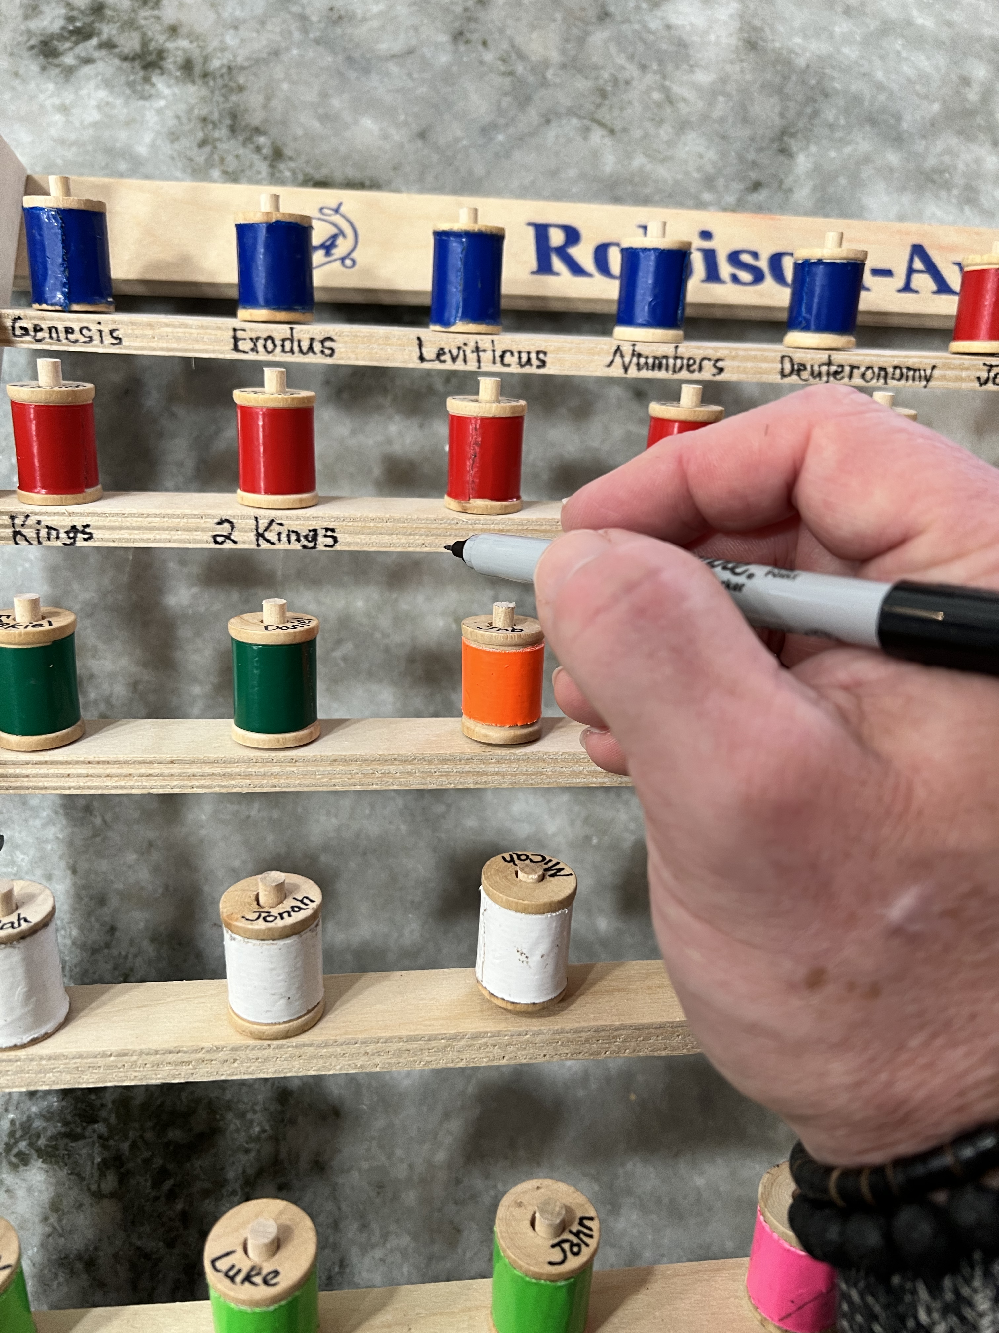
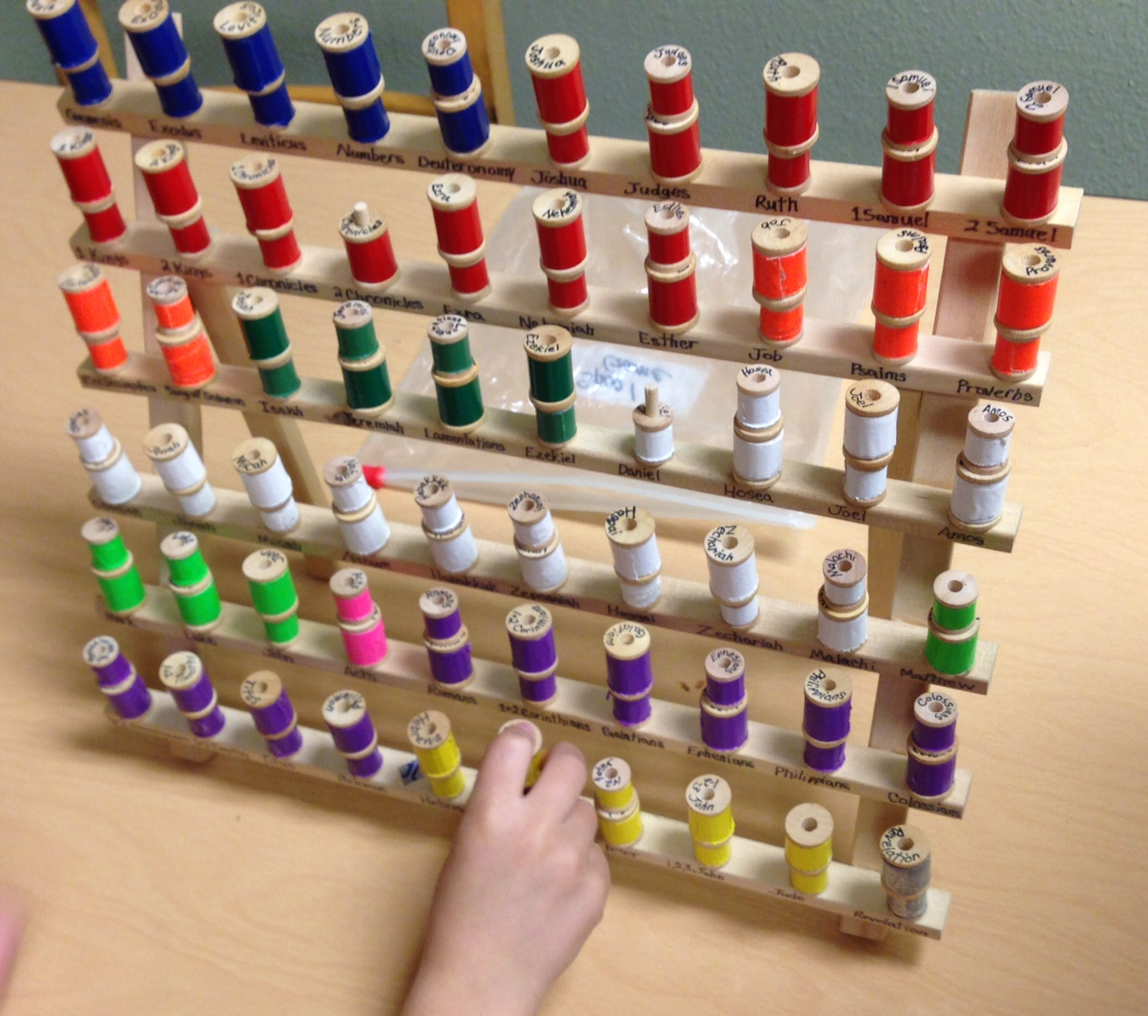
Early arrivers =
Bible Skill Games

Slide 15
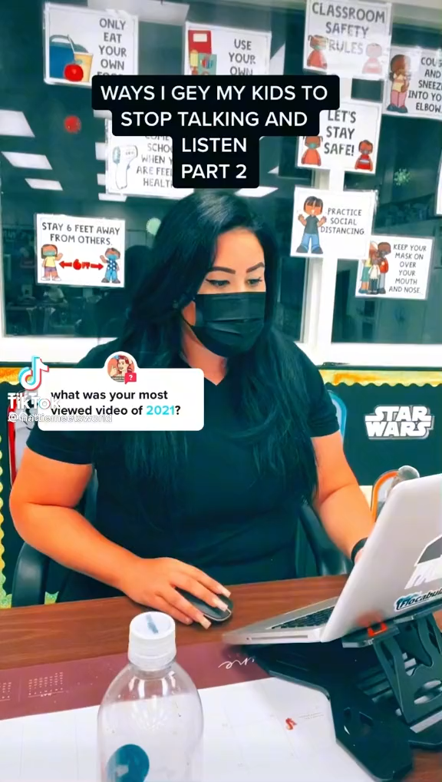
Call and Response
Shark Bait…
To Infinity…
Knock, Knock...
Bing, Bang...
Give Me Three...

Slide 16
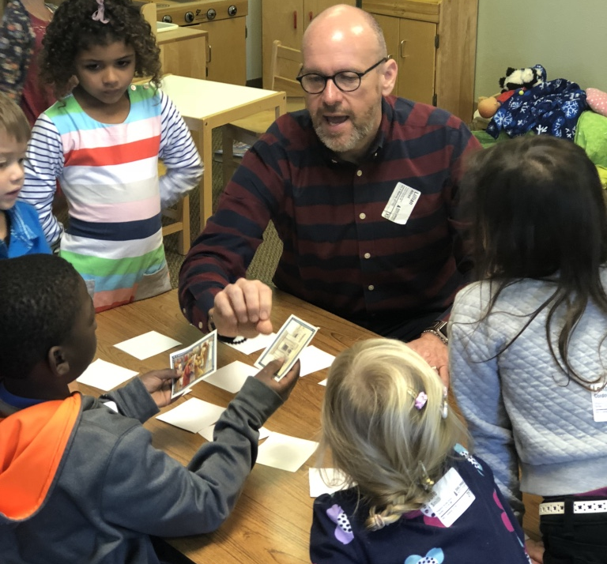
Large Group Transitions
Inform time to finish
Countdown as needed
Give specific assignments
Affirmation for good choices
Clear instructions for next activity

Slide 17
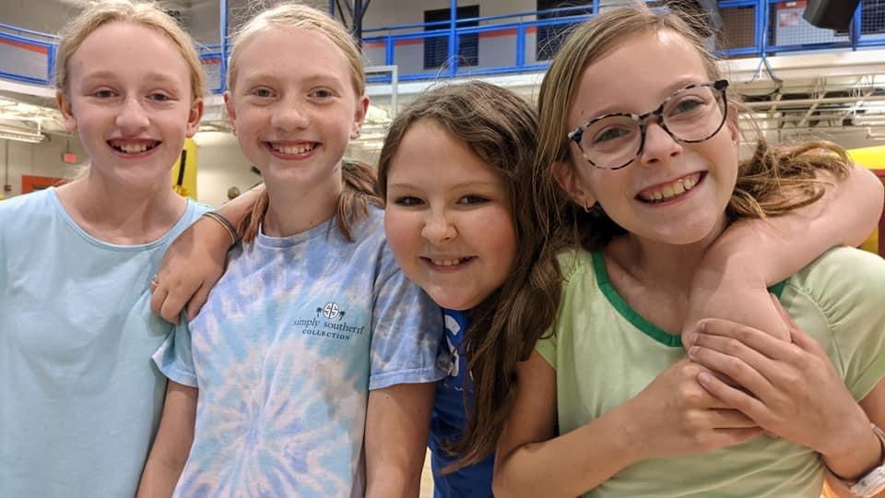
Taking Turns to talk
Raise your hand
Come stand by me
Group discussion

Slide 18
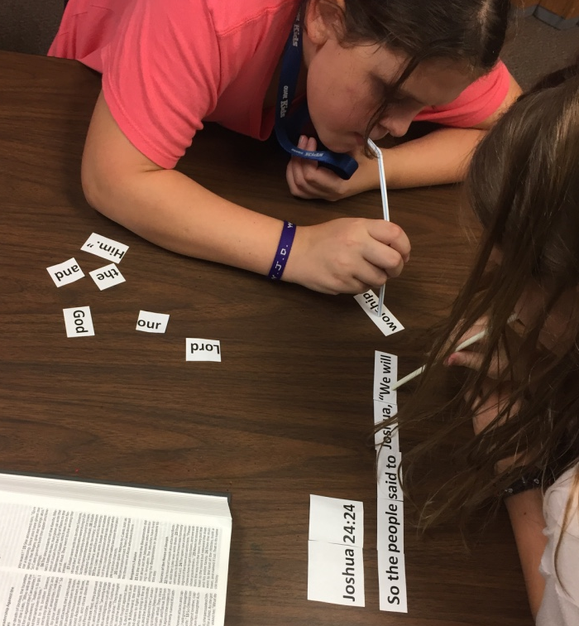
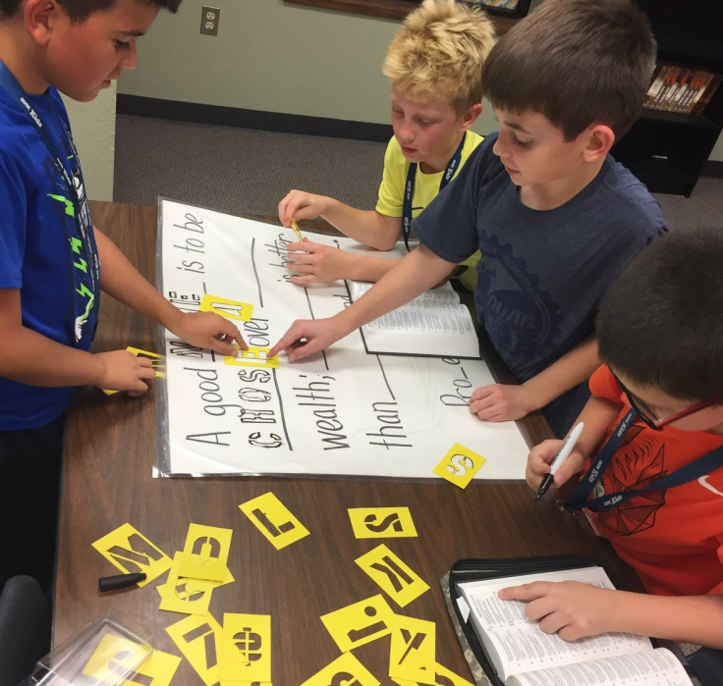
Teaching Older Kids
Practice Bible Skills
Building Community
Facilitate Discussion
Transition to Inductive Bible Study

Slide 19
Other Procedures
Restroom time
Assigned job
Walking in line
Dismissal

Slide 20
Leading With Classroom Procedures
Mark Jones
Facebook- Mr. Mark’s Classroom
Pinterest- Mr. Mark’s Classroom
Instagram- @mr.marks_classrm

